Slide 1
Compressed Sensing for Structure Health Monitoring Data: Case in Tunnel Monitoring
MATH 5473 Project Presentation
Presenter: Ang LI (20994805)
Department of Civil and Environmental Engineering
The Hong Kong University of Science and Technology (HKUST)
(Email: lionel_a.li@connect.ust.hk)
May, 2024

Slide 2
Outline
Introduction
Methodology
Fundamental of Compressed Sensing
Reconstruction Algorithm
Case Study
Case Description - Tunnel SHM system
Compression of the collected signal
Signal Reconstruction
Signal Reconstruction Accuracy Analysis
Summary

Slide 3
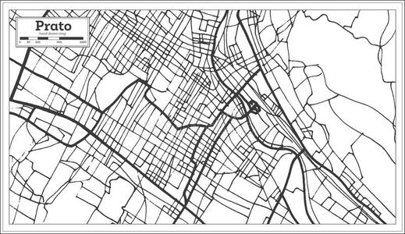
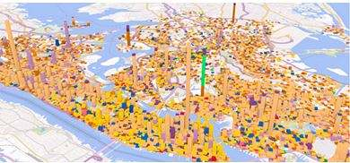
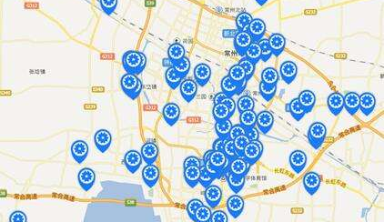
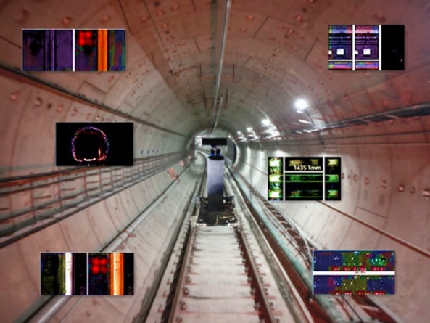
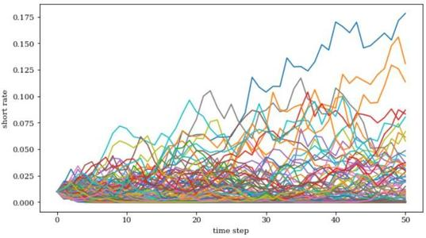
Introduction
Problem Statement
The large volumes of sensor data generated from the monitoring system has challenged the data transfer and storage
Multiple sensors, continuously monitoring
Compressed Sensing (CS) can reconstruct data with much less number of acquired samples than that defined by Nyquist's theorem
Numerous data
How can we apply Compressed Sensing on Structure Health Monitoring data to reduce its data volume and recover data accurately?

Slide 4
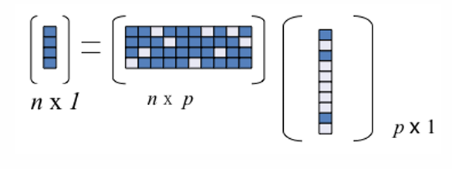
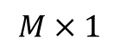
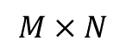
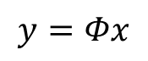
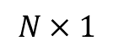
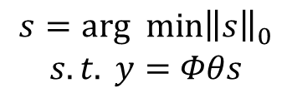
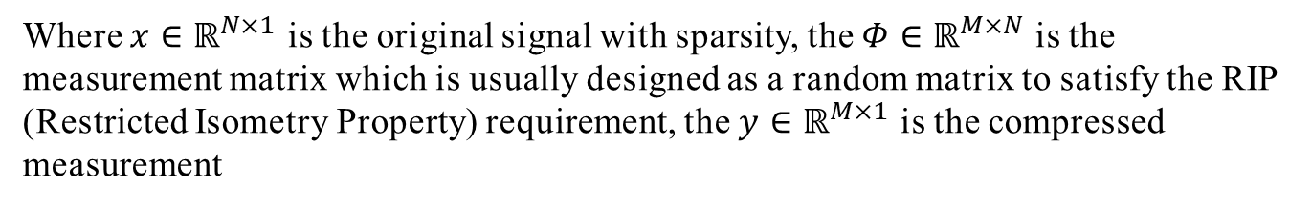
Methodology
Fundamental of Compressed Sensing
CS can be represented as a linear equation
$$y=Φx$$
Where $x∈ℝ^{N×1}$ is the original signal with sparsity, the $Φ∈ℝ^{M×N}$ is the measurement matrix which is usually designed as a random matrix to satisfy the RIP (Restricted Isometry Property) requirement, the $y∈ℝ^{M×1}$ is the compressed measurement
$$M×1$$
$$M×N$$
$$N×1$$
The solution of the equation can be solved via the minimum the l₀-norm optimization, which is a NP-hard combinatorial
$$\begin{matrix}s=arg min{\left\|s\right\|}_{0} \\ s.t. y=Φθs\end{matrix}$$
$x$ can be represented as $x=θs$ by assuming it has k-sparse in domain $θ∈ℝ^{N×M}$

Slide 5
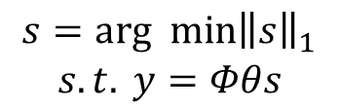
Methodology
Reconstruction Algorithm
(1) Convex optimization: Basis Pursuit
Convert relaxation have been proposed to obtain a solution similar to the l₀-norm, basis pursuit (BP) solve the optimization by minimum the l₁-norm
(2) Greedy Algorithm: Orthogonal Matching Pursuit
Orthogonal Matching Pursuit (OMP) utilize the combination of local optimization to solve the optimization
$$\begin{matrix}s=arg min{\left\|s\right\|}_{1} \\ s.t. y=Φθs\end{matrix}$$

Slide 6
Case Study
Tunnel SHM system

Slide 7
Case Study
Tunnel SHM system
The original data is not sparse, but frequency domain obtained by Fourier transform shows sparsity

Slide 8
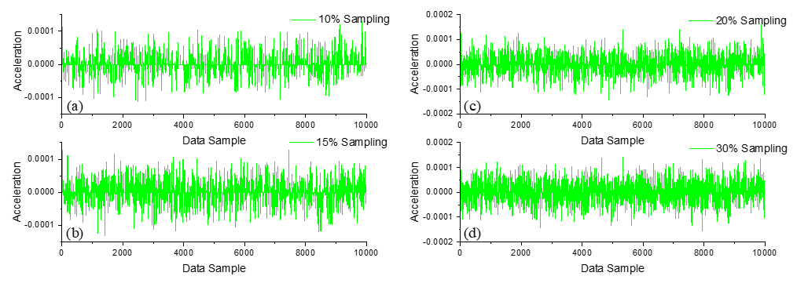
Case Study
Compression of the collected signal
The 10000 data samples obtained from sensor No. 1 to illustrate compression:
The data samples are randomly selected using random matrix to reduce its volume
The sampling rates are set to 10%, 15%, 20% and 30%, respectively.

Slide 9
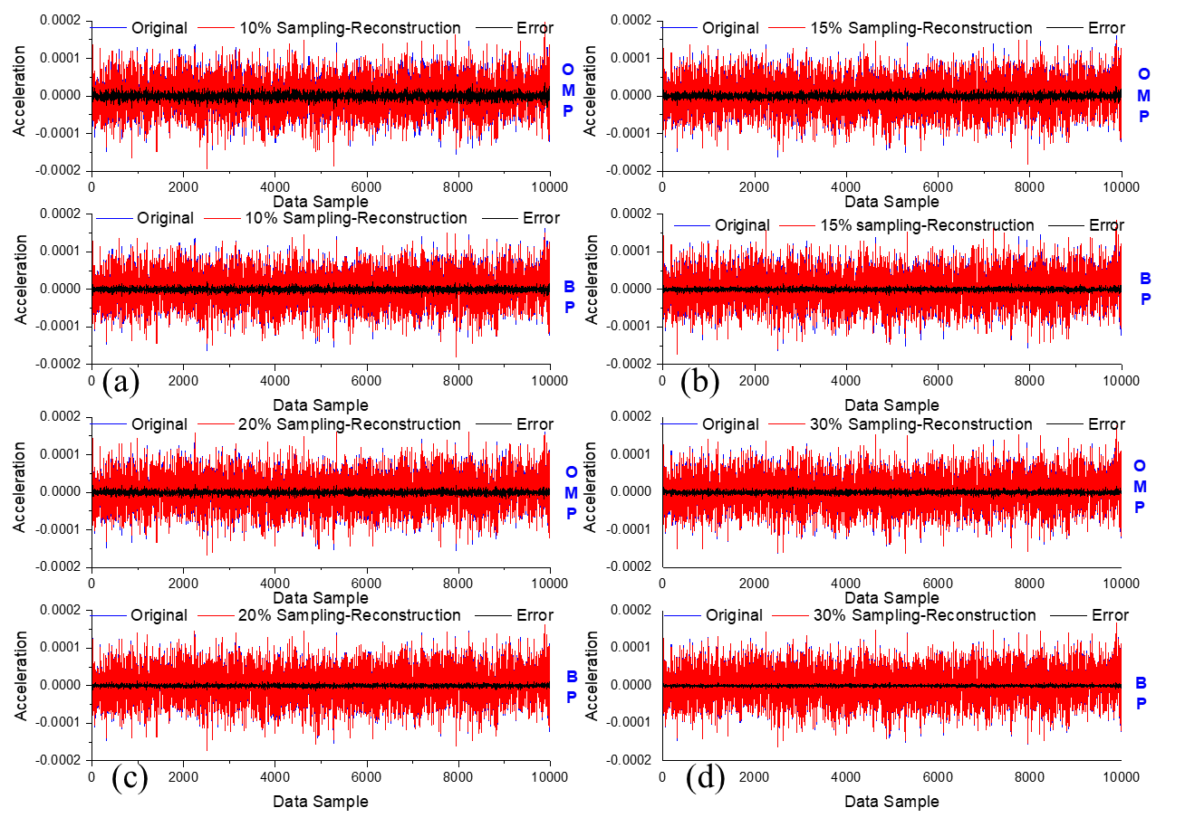
Case Study
Signal Reconstruction
BP can OMP can successfully reconstruct the signal from the compressed date:
The reconstruction accuracy of the BP algorithm surpasses that of OMP
Higher data sampling rate leads to a higher reconstruction precision

Slide 10
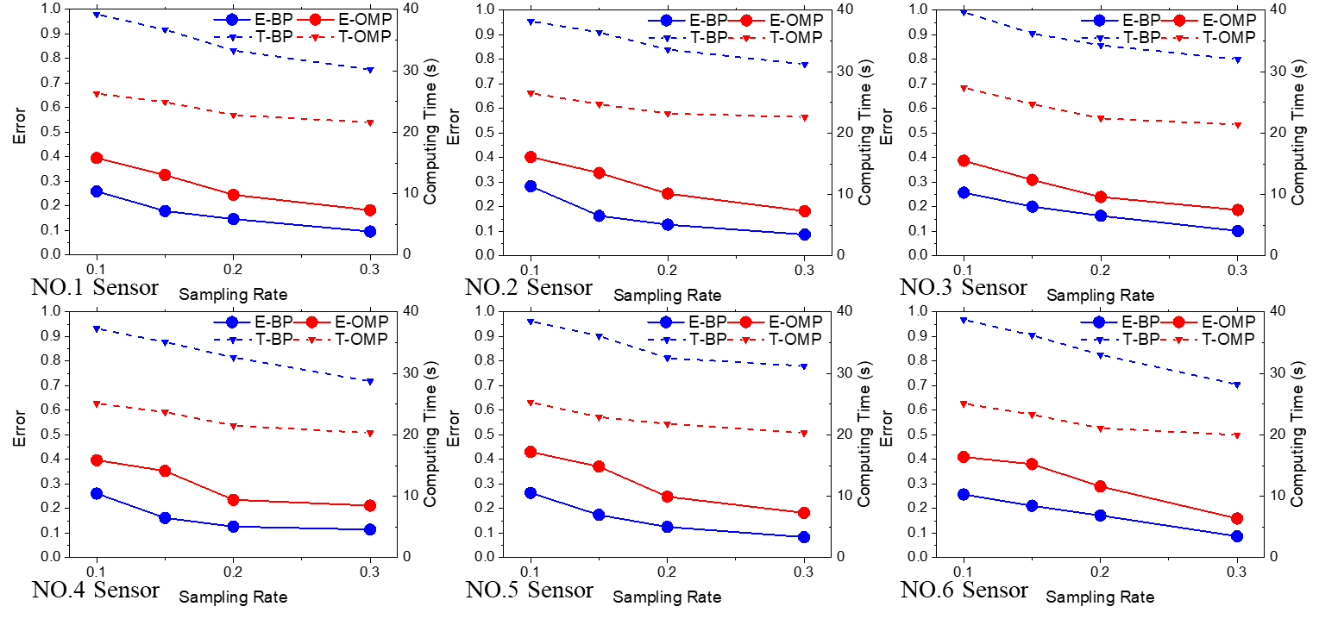
Case Study
Signal Reconstruction
BP and OMP have different performance :
Reconstruction Error of BP is about 30% lower than using OMP to reconstruct
OMP algorithm requires significantly less time (spend about 10s less) to reconstruct the signal

Slide 11
Summary
Addressing the problem in transmitting and maintaining large amounts of SHM data, this project used a tunnel SHM dataset as case study, then compressively sampled the monitoring data at different sampling ratio, subsequently reconstructed the signal with BP and OMP algorithms and analyses the reconstruction error.
The results of case study indicate that:
tunnel SHM date can use CS to efficiently compress and successfully reconstruct
BP has higher reconstruction accuracy on tunnel SHM date than that of OMP, while BP has worse performance on computation time and consumption than OMP
Increasing sampling rate can reduce reconstruction error and computation time for both BP and OMP

Slide 12
THANK YOU!

